Slide 1

The Four Mile Rule & Other Lessons
“I wanna tell
you a story”
Notes:
For those of you too young to remember the catchphrase, “I wanna tell you a story”, it belonged to Max Bygraves, one of the early popular entertainers of the 50s and 60s. He died in August 2012 after being diagnosed with Alzheimer’s disease. So, it seems to be appropriate to use his words to describe the conception, development and subsequent evolution of The Debenham Project. As to the title of this presentation, and thanks to Nick for suggesting it, I hope that its meaning will become clear as we proceed.
On an evening in February 2009, during a small meeting of the elders of our parish church someone (to this day I cannot recall who) said that “dementia would be a serious problem for our community. Although there is a critical national need in enabling and funding health and social care, the real impact falls on family carers, relations, friends, and neighbours and of those with the illness i.e. the community”.
From that, not altogether, chance remark, the flame that led to the Debenham Project was ignited. I remember the conclusions of that meeting were that we must try to do something but, back then, we didn’t know how to respond to our concerns.
Firstly, however, a little about Debenham:

Slide 2
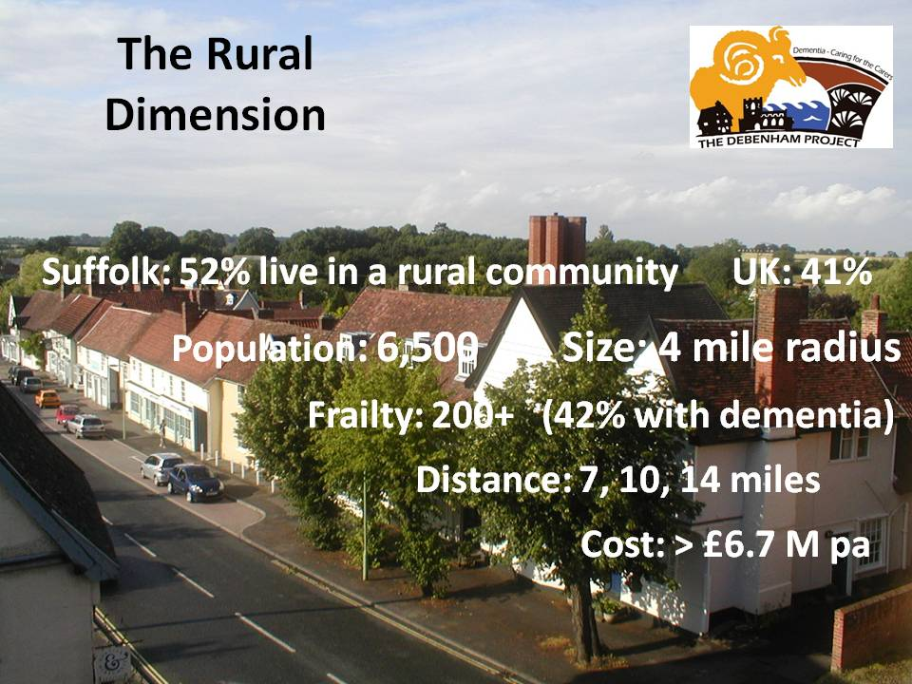
Notes:
Debenham and its surrounding villages is typical of the rural communities in Suffolk and the UK. They represent slightly over half of the population of our county, and more that 40% of the overall population of the UK as a whole. When we take into account the age profile, we find that over 60% of the “over 65s” in Suffolk live in such villages and towns.
When you look at the slides in this presentation, you may be forgiven for thinking that Debenham is a privileged well-to-do historic tourist village, but this is definitely not the case – It is true that it does have a High Street of lovely Tudor and Georgian buildings but, beyond that, it is no different from any other natural centre of population in an essentially rural county. Most of its residents live “behind” the “pretty” centre in classic 50s, 60s, 70s, and more modern bungalows, semi-detached, 3 / 4 bedroom detached, council, housing agency, and affordable housing. We are fortunate to have both excellent primary and secondary schools, a small supermarket, a post office, a bakery, a greengrocery, cafes, a small library, a small business park, a vibrant sports and leisure centre, a couple of pubs, and several more local high street businesses. In fact, roughly speaking, what you would hope for in any large village or market town. I frequently use a set of pictures that show the “actual” picture of Debenham beyond the nostalgic image – We are “normal” and not “unique”.
Our community has a catchment area of roughly 4 miles radius with a population of approximately 6,500. For Suffolk, 4 miles is “half-way between here and somewhere else”. How we define the community in which we live is so important because it gives a focus on the what, who, why, when, and where. In our case it is purely geographic – all those people who live in Debenham and its surrounding villages – those who might see Debenham as their natural centre of population – the place that they often go to for shopping and other social activities – a place they are familiar with and where they have friends – a place where they will often bump into people that they know and can chat to – somewhere that they have a history and connection with – in other words our friends, neighbours, relations, and acquaintances.
In 2010/2011 there were over 200 people who might be described as “frail elderly” by virtue of being known to Adult Care Services – 42% were thought to have significant symptoms of dementia – 110 were in residential or nursing care but had a previous address in Debenham. What does this latter statistic mean? That 110 elderly persons had to leave their partners, relatives, friends, neighbours, and friends because they could not be cared for in their own community – “7, 10, 14 miles is too far”. Why cannot they be cared for where they live, and are familiar with their surroundings and those they know?

Slide 3
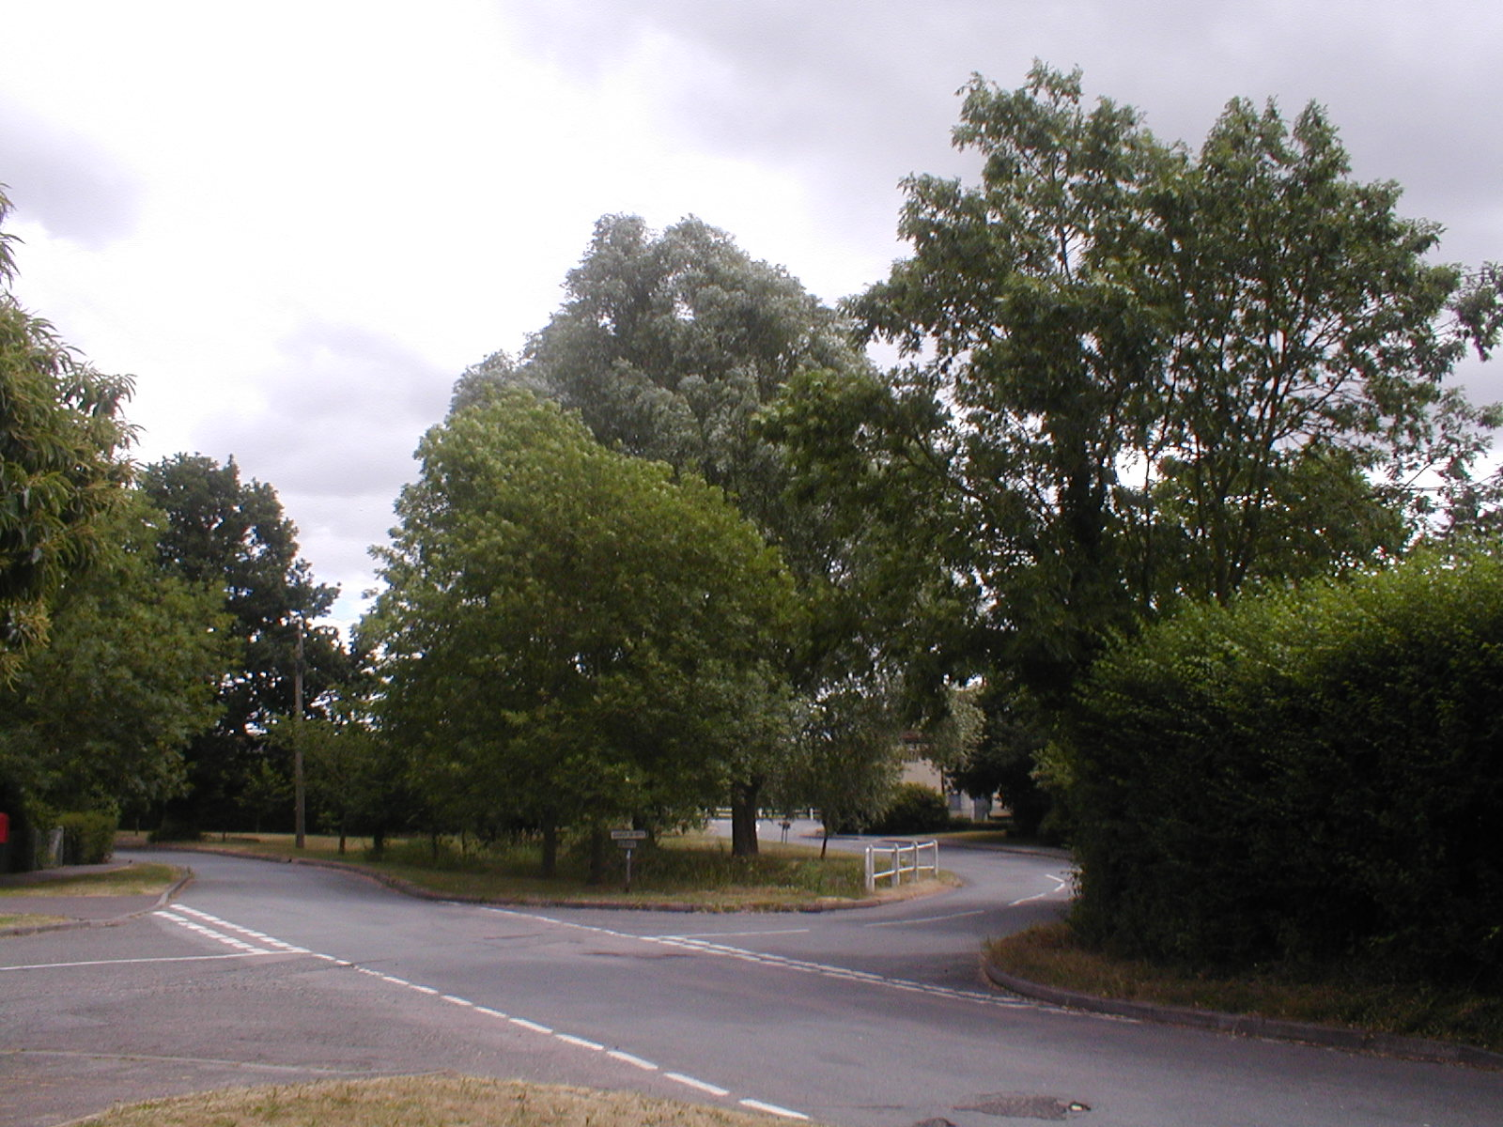

THE DEBENHAM PROJECT
Dedicated to the support of Carers of those that have symptoms of Dementia and those they Care for
Notes:
In the absence of having any real idea of what to do to “make a difference”, on the 23rd of April 2009 a public meeting was organised simply to try to raise awareness of the nature of dementia and the impact that dementia would have (was already having!) on our friends, our relations, our neighbours, and our community. It was that meeting that shaped and ultimately launched The Debenham Project with the aim of providing the best community-based support for family carers of those with symptoms of dementia and those they care for that we could. We have, over the last five and a half years, sought to meet that challenge and have been recognised for our achievements locally, county-wide, regionally, and at the national level.
I vividly remember that April evening. It was arranged as an information event with four panel members, each giving a short presentation of a particular aspect –the senior partner of the GP practice, a retired neurological consultant, a senior accredited social worker, and myself (of no relevant qualification except as having been the primary family carer for my mother). I guess we imagined that perhaps only a few people would turn up, particularly as it was not a very nice evening. However more than 70 came – standing room only! - and together the philosophy, foundations and guiding principles of the project were formed. For those who worry about “understanding the needs of potential service-users”, “engagement with service users and service providers”, and “surveying the views of the stakeholders” this was our primary consultation phase! It guided us as to how to start, but since then we have depended upon being “close” and “listening” (that means we are always involved in every Carers Club, Info Café, Fit Club, etc.) to each and everyone who is happy to come to our clubs, activities, and sessions. We are also directly “in touch” with “the word on the street” – people will often stop to talk, and what we are up to often comes up in the conversation – and so, The Debenham Project is, in a sense, a continual focus group keeping us grounded in the reality of what is needed and what is happening.

Slide 4
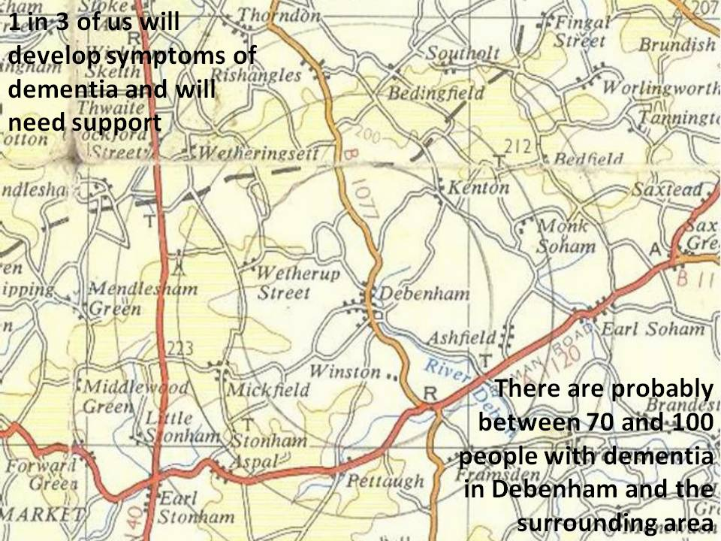
Notes:
Apart from 4 miles (that’s the outer circle in this diagram) being “half way between here and somewhere else” suggesting a natural geographic basis for our project, we felt that there were at least a couple of other very important factors in choosing such a criterion.
Firstly, we needed to concentrate on doing what is possible, and not trying to overreach by trying to help everyone. Within our catchment area we estimated that there were between 70 and 100 people with symptoms of dementia with a varying degree of severity from mild through to severely disabling. And their families, friends, and neighbours who were caring for them had no local support other than their GP, and almost no support available elsewhere in the health and care system. I well remember, in the earliest days, walking the length of the High Street with Suffolk’s lead on dementia and pointing out each house where there was a family having to cope with the impact of the illness on their lives and needing support (however little!) and arguing that although the scale was challenging it was not daunting – if we could make some difference for a significant percentage of these families and individuals, it would be worthwhile – but to try to spread our support wider would, almost certainly, be a step too far – we had to be a “community” project - and that remains our total commitment.
Secondly, and at the same time, I suggested to him that there was a tremendous goodwill and willingness of local people to “get alongside” and support those family carers, and those they cared for, because they understood (they felt for) what they were going through – many had been there – others had been close to those who had the illness or who were currently family carers – and knew the massive impact it had on their physical, mental, and social life. However, the strength of their concern was for those in their own community who, even if they did not know them, might well periodically recognise them in the street as local residents and with whom they could “pass the time of day” i.e. the potential for a personal connection and a continuing social relationship was present. The argument being that, as a purely voluntary organisation, it is local people that are especially motivated to offer their help to those they know - those in Debenham and its surrounding villages.
One in three of us will exhibit symptoms consistent with a diagnosis of dementia when we die. That, sort of, implies that there is another one in three of us who will, at some stage in our lives, probably become a family carer, usually later in life when we are more frail. This is the scale of the problem facing all of us and the communities we live in. Dementia should not be seen as a “national” problem that is the responsibility of the Government, the NHS, and the local authorities to solve. Clearly, there is a national dimension requiring investment in research, the provision of diagnosis and other clinical services, and a strategy for health and care support. But primarily the continuing care and support that is needed will have to come from within the community and involve not only local GPs and nurses but mainly those friends and neighbours who are willing to give some of their time towards the lunch clubs, peer support groups, cafes, transport, befriending, activities and social involvement, information and advice, personal contact, etc., etc. that we know can lift the quality of life of a family on the edge of surviving, to be able to cope and avoid (or at least delay) the crises that inevitably herald a downward spiral in their well-being.

Slide 5
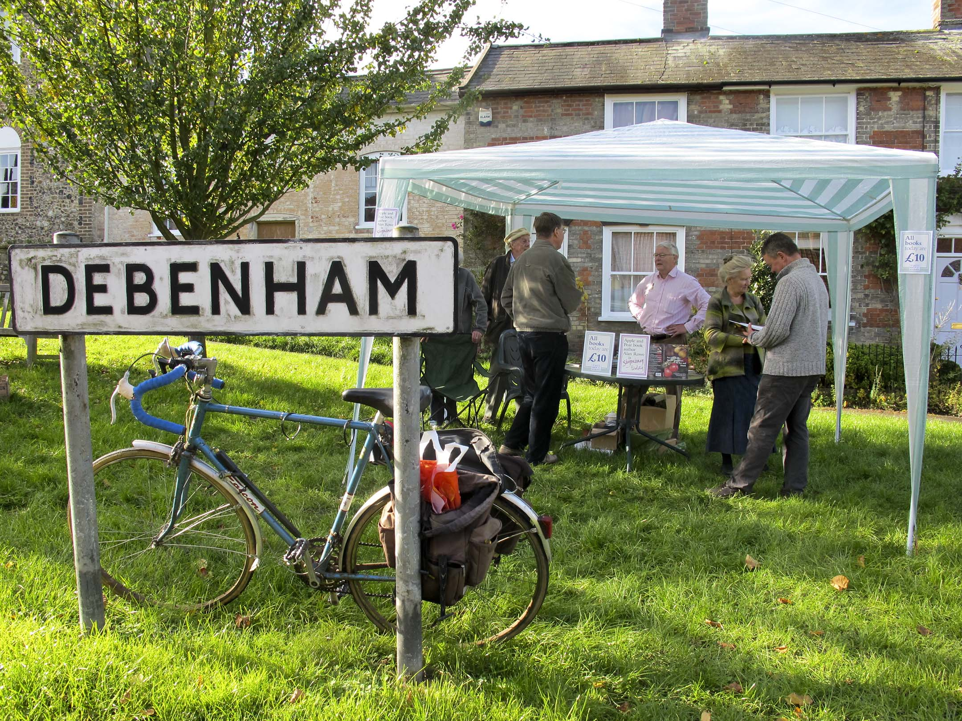
The Debenham Project
(April 2009)
“There is an obvious need”
“Get on and do something”
“Focus”
“7, 10, 14 miles is too far”
“Tell us what to do”
“But have a Vision”
Notes:
The seven guiding principles that those who attended that meeting in April 2009 asked us to follow were:
1. “Pay no attention” to national and other strategies – This is our contribution to supporting our friends and neighbours and we probably know better what will help.
2. “Get on and do something” – You will quickly know what is working and what is not. You won’t have wasted time trying to decide what might be best when you could already be delivering the support you set up the project for.
3. “Avoid, at all costs, bureaucracy, both ours and theirs” – Meetings and paperwork are no substitute for confidence and usually result in high overheads and delays.
4. “Focus” – You can’t solve all the problems of the world so concentrate on doing what you can and don’t become diverted. For us this meant:
Support those in our community i.e. the 4-mile rule
Focus on supporting the family carer - generally it is mostly the carer that takes the brunt – but recognise that by supporting the carer you are supporting the cared-for and vice-versa. They are inextricably linked, so try to care for them together as a family unit.
5. “7, 10, 14 miles is too far” – In our case the only locally-based services are the GP and the community nurse. It is critical for those with the illness to have the familiarity of location and people, and not to have to cope with a significant journey before and after participation. For the family carer the most important element in their support are the relationships, peer support, and friendships that come from continuing to be accepted as part of the group – knowing that they are not alone and that people personally care about them.
6. “Tell us what you would like us to do” – There is a huge amount of goodwill – almost everyone has been touched by the illness and many, many are willing to help – but follow the maxim that “it is better to have a lot of volunteers each doing a little than a few trying to do everything”.
7. “It is our project” - Ownership must rest with the community – Pride in the achievements of the project binds us together and encourages us to do more.
However, we were also asked to “have a vision” of how, as a community, we wanted all those amongst us who are becoming increasingly frail in their older years to be supported and cared for. Without realising it, alongside the “here and now” of helping families coping with dementia, this request triggered a 5 year research/consultancy which has explored how our rural community might respond to the very real needs of our ageing population. But that is a different story.

Slide 6
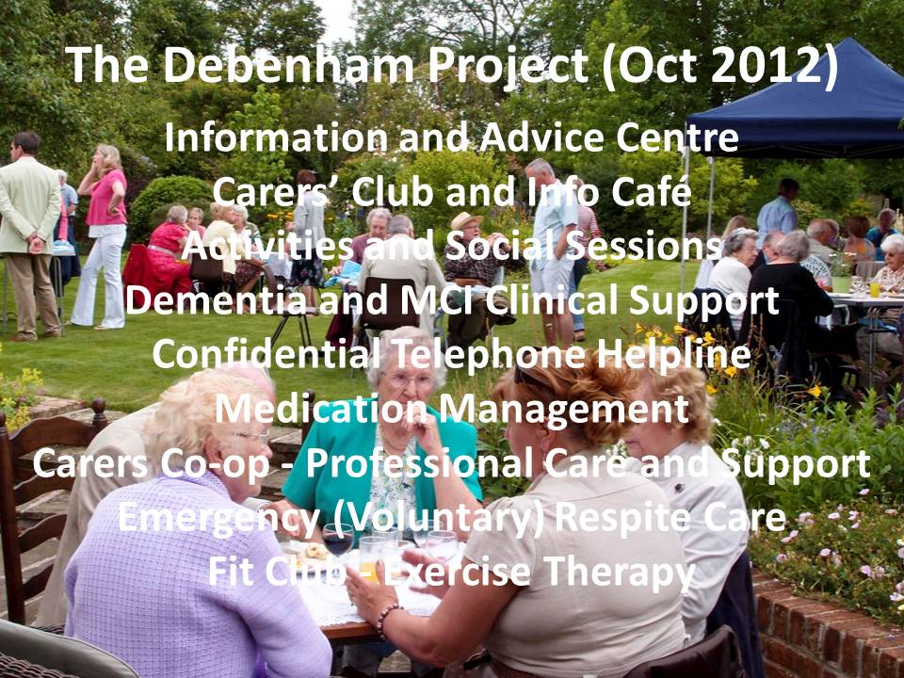
Notes:
In October 2009 The Debenham Project was formally launched to an audience of 150+ and with the active collaboration and support of the mental health trust, adult care services, the 3 major charities, the library, the church, the post office and so on. We managed to have set up our initial advice and information centre, adapted a friendship group for the elderly (CAMEO) into an activities and social group, initiated our first Food ‘n’ Friends lunch club, and had just about managed to get a confidential telephone helpline into operation – all pretty rudimentary and fragile BUT THERE!
Three years later the project had evolved and matured with added activities and services – the Carers Club and Info Cafe, the Fit Club and Debenham-on-Call, the Carers Co-op, a register of local professional care and domestic help, etc. - and so it has continued up to this day with the addition of an informal volunteer transport network , and a small relaxation therapy group. The latest things we are trying are a “WAY BACK WHEN” reminiscence group and indoor kurling. Some others e.g. the confidential telephone line and the local diagnosis clinic have been superseded by the statutory agencies – we do not want to “hang on” to offering services when there is a better alternative. More information on each of our activities and services can be found in the latest version of “This is: The Debenham Project” booklet at http://www.the-debenham-project.org.uk/downloads/booklet/150601booklet.pdf.
Frequently, entrepreneurs and businesses are asked “what is your USP (unique selling proposition)” because of its importance in becoming and remaining a sustainable enterprise. Certainly, we are not a commercial organisation based upon the primary need to deliver a financial dividend to shareholders, but much the same rules apply – if we do not provide the support that makes a difference to the quality of life of those we are seeking to help, we should not be wasting the goodwill and time of our volunteers. In our terms, USP might translate into “what characterises the various things you do?” and “what makes them important to those who come?”
Primarily, they are about responding to the individual needs of those who may be struggling with the impact of dementia on their lives. Some of what we offer directly relates to helping family carers cope with the everyday problems e.g. getting to and from a medical appointment at the hospital or GP surgery, helping with emergencies, finding personal care or domestic help, or accessing specific information, advice and support. However, much more relates to maintaining social connections, friendships, peer support, someone to talk to, knowing you are not on your own, having something to look forward to, a couple hours of “my space”, respite, being able to share problems, etc. but all in a safe, friendly, caring, environment.
Actually it is much simpler than that: It is about encouraging a “family” of friends and neighbours who want to help by organising and running a lunch club, a relaxation group, activities and social sessions, reminiscing get-togethers, chair-based exercises, afternoon cake clubs, and anything else that we hope could help make life “just a little bit better” for “just a little bit longer”. And so it is that we “heavily lubricate everything we do with chocolate cake”. Not so stupid or extravagant as it sounds to some ears responsible for the decision making in dementia care provision!

Slide 7
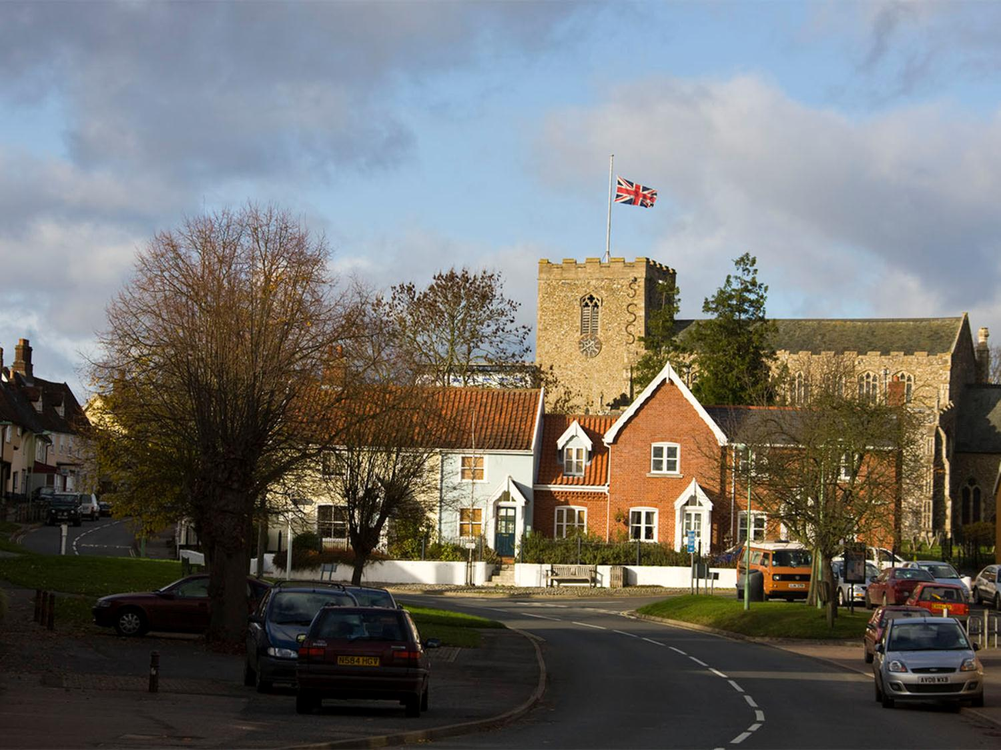
A Community Led and Owned Project
Local Provision of Services
Voluntary Provision of Services
Drawing in Professional Services
Services Tailored to Local and Individual Needs
Access to Information and Services through a Single “Doorway”
Holistic
Notes:
You will gather that I prefer to talk about the project in terms of how its participants enjoy and benefit from the simple truth of “it being there” – the simple truth of how it offers “a caring hand”. However, having conversations with a wide spectrum of decision makers and those professionally involved in the health and care sector is fundamental to the success of any community project. We have to understand their language and where they are coming from.
So here are some key elements of the project duly expressed in the terms that persuade and encourage government, local authority, NHS, and corporate support.
Local services: It is all too easy to argue that centralising services over a larger area is more cost efficient and can deliver a larger variety of activities and facilities. However, this approach must be resisted. Firstly, it is difficult for carers, and stressful for those with dementia, to travel 7, 10, 14 miles to a diagnostic clinic, to attend a peer support group, dementia café, or for advice and information. Secondly, local support is generally much more familiar in terms of the people and the venue, and will also be more convenient in terms of the time and availability. These things are terribly important. It is so much easier when such services are within their own community and organised by people who know (often known for years) the people they are seeking to help.
Voluntary: The evidence is that when projects grow from within communities, there are many who, having been family carers themselves, want to “come alongside” those who are currently struggling to cope – but they need to feel that they are supporting those around them who are their neighbours and friends - and not just a helper at the end of the “professional” chain. It is also without doubt that the statutory authorities and the major charities, however committed, cannot provide the sort of community- based care and support that existed “in years gone by”. Where does that leave us? I am sure that if we approach, encourage and engage with local communities and the voluntary sector in the right way, most will want to “get on and do something” to help. The key question is: Will the councils and CCGs support and encourage them without worrying unduly about how they go about it? For us at the beginning and ever since, one thing stands out – “ownership”. I believe that it is vital that if volunteers are wanting to give up their time to make a difference, they want it to be “their project” and “their enterprise” in the same way that a small local business is seen as the result of hard work and commitment by everyone in the workforce. It is highly motivating to create something that is successful and something to be proud of. So it is with a community-based project and the implication is that ownership must rest with volunteers and the participants in project. They must feel that they are “in control”. This means that the professionals, statutory agencies, funders, etc. must avoid inadvertently wresting that control and ownership from the community – their role is to stimulate, encourage, support, etc. and not to direct, regulate, standardise, specify, etc. That is, to create an environment in which a project has the best chance of flourishing and growing even though it might not be in exactly the way “I would have done it”.
Professional Support: When we started this project we made it very clear that it was not to be seen as “saving money” for the local authorities. We were to be about providing caring support which was not being provided by the professional agencies. In all probability, these would be the kind of services that, almost certainly, the NHS and the Social Services could not successfully deliver without full engagement with local volunteers and community-based projects. The primary reason being that the nature of post-diagnosis support is essentially “palliative” and “preventative” rather than “interventionist” – there is no cure for dementia and the aim must be to “maximise the quality of life” for both the person that has the illness and the person that cares for them. This involves maintaining and developing ongoing (over years) unconditional relationships, socialisation and interaction, physical and intellectual activity, etc. which need the familiar and (dare I say it?) loving support of relations, neighbours, friends, and volunteers.
So, what is the role of the professional in this model of care? The Debenham Project has perhaps, by accident or ignorance, developed a new model for the way that communities might interact with professionals. At the very onset of the project, we recognised that volunteers cannot replace the academic education, the training, and the experience of professionals, and that this professional resource is critical in the care of our ageing population - particularly in the care of families living with dementia. However, the majority of what is actually needed is common-sense and needs only social skills combined with a general understanding of the illness and how to relate to carers and those they care for – but, and most importantly of all, the motivation and desire to care. However, when (and not if!) professional skills and knowledge are required these can be “drawn in” as needed. Thus, instead of the traditional structure of a top-down hierarchy with volunteers supporting professionals, we are an example where the community “owns” the bottom-up project and we ask the professionals to provide support as and when it is needed – a total reversal of the current way of doing things. We believe that this is the only way that truly person-centred care can be delivered – “Caring for the Community, Caring in the Community, and Caring by the Community”.
Tailoring services to the local need: It is obvious that every community is different in its nature, geography, demography, structure, resources, priorities, needs, personalities, vibrancy, and confidence. So, why is it that central government, the NHS, local government, and even the major charities are so concerned with providing a “standard” service? That is another question that we can debate later, but suffice to say, I believe it is more about cost efficiency than cost effectiveness. Actually most businesses realise that they have to “adapt and respond to the market” and that means seriously thinking about what every one of their potential customers’ wants and needs. In our terms – everyone who is going through the dementia journey is different – they need help, but the what, when and how are not predictable except in the most general terms. What we, as those who are hoping to help make their lives a bit better, need to do is “be there for them” and to respond to their individual needs when they surface. I believe that when communities seek to support their fellow residents, neighbours, and friends, they instinctively know better than anyone else what is needed. It is about personally knowing (or personally getting to know) them – not easy for a remote clinical service. Again, as far as The Debenham Project is concerned, we have not followed the “standard” approach to deciding what services and activities to develop.
The commonly accepted view is that, in order to be successful, it is essential to create a management and advisory structure in which all the stakeholders (and especially service-users) are represented and are directly involved in the decision making and running of the organisation. Without this it is not possible to be able to identify and respond to the needs of those we are seeking to help. I believe this to be wrong and The Debenham Project has demonstrated this. What our project has is a very lean loosely distributed structure which is based upon enabling individual services and activities to evolve within an overall umbrella. Each service or activity is a self-managing group with a few volunteers one of whom is broadly the task leader. The groups run themselves naturally with almost no intervention from above. My role – “the overhead” - is just to make sure that they have the resources, the money and the support to do what they do best – offer a bit of respite, support, advice and help to their friends and neghbours i.e. to care.
Needs: How do we know what will really make a difference to the quality of life of a family carer and the person they are caring for? For those who are tasked with providing health and social care to our ageing population, this is the $64,000 question. Quite rightly, they seek to find out by asking and organising consultations, focus groups, and engagement events. Whilst these deliver valuable data they do not, for those elderly and usually frail family carers and their frail partners, capture the cares and experiences of the majority of those who are struggling to cope. What is it that hurts them? What is it that for them can make a difference to their quality of life?
As I mentioned earlier in this presentation, we set up an initial public meeting in April 2009. That was perhaps the only formal consultation element of the project. It must have been successful since, nearly 6 years on, we are not only still here but have continued to evolve to meet the needs of our service-users. Why is that?
Again, I repeat that The Debenham Project doesn’t quite fit into the accepted approach of directly involving service users in the design and management of the project. The way we have ensured that we are doing the best we can to support service users in our community is threefold:
Almost every one of our volunteers has been directly impacted by the illness as a past or current family carer, a relative, friend or neighbour, or a professional in the field.
The leadership of the project, trustees, etc. are also volunteers helping in the week-to-week running of the clubs, activities, and services at which they are in direct contact with both carers and those with the illness.
We are active in the wider (county and national) scene and learn from others what ideas we might try to implement.
Thus we believe that we are always talking to family carers and those with the illness, and developing, maintaining, and understanding their needs - “Reaching out and touching is the only way to deliver truly responsive care”.
More formally, we did initiate in 2012, funded by the Norfolk and Suffolk Dementia Alliance, a major research project to explore the experiences and perceptions of the “dementia journey” for as many of those families known to us (over 60% of the estimated numbers with the illness in our area and almost 90% of those who had participated in the services and activities offered by the project). Whilst this proved to be a significant piece of research which was recognised by its publication at national level, I don’t believe that it taught us anything that altered our understanding of the difficulties that family carers faced in caring for their loved ones. We also conducted an interesting review in 2014 – The Charitree – which solicited the views of participants and confirmed the value of the work of the project.
Access to information and advice: One of the key requests of family carers following (and also before) a diagnosis is to “understand” – to have the information to process what is happening to their lives, to know what the future will bring, and how to “make things better”. However, mostly what they seek is someone to talk to who understands their situation and who can signpost them to more information, if that is what they want, but more often, a listening ear that can help them in coming to terms with the diagnosis. This is no different from someone who has just received a cancer diagnosis. So why is there a difference when it comes to dementia in the provision of support by the statutory agencies? – you will perhaps sense a certain frustration in me.
The policy of The Debenham Project has, from the very first, been to offer very simple straightforward leaflets which try to say “Things haven’t actually changed since yesterday, they are same today, and will not be any different tomorrow. There is no rush but it would be good to think about a few important things - like talking with someone who understands your situation, sorting out some “legal” things like Power of Attorney, wills and financial matters, and recognising that there is some brilliant support just waiting for you – but you might surprised how much of it involves chocolate cake and chocolate biscuits!”
What we find, is that there is a very understandable need expressed by newly diagnosed patients and their nearest relatives/carers for information and a clear knowledge of how things will progress. However, when it comes down to it, it is a need for reassurance that they are not alone and that there are so many who have followed their journey and who will try to be “there for them”.
Whether it is for information, advice, signposting, access to services and activities, respite, or any other of their needs, they ideally want someone local, someone they know or can get to know, that they can turn to for help. Some of the current terms used in the professional sector in this context are care coordinator, keyworker, link worker, single point of contact, dementia support worker, dementia advisor, etc. It seems that there are a multiplicity of these and probably a serious source of duplication of effort.
We have preferred to talk of The Debenham Project as helping those we care for to “walk through a single doorway” – hopefully, with a common-sense approach to managing only the things that matter when they are worried about them - and not overloading them with information, but guiding them to the right people, and sharing the experiences of others in coping with their problems.
We also have what we loosely think of as a local “Advice and Information Centre”. However, it isn’t a centre. It currently consists of an attractive leaflet display in the village Post Office, a collaborative relationship with our village library, a website, monthly articles in the Parish Magazine (I have lost count of how many I have written but it must be close to 70!), an Events Diary, and also a newsletter (which I admit can be very difficult to produce as regularly as I would like).
So, if we put this together, what does it amount to? I hope it provides a range of opportunities for service users to, not only, to pick up some initial information locally, but also to be guided naturally to The Debenham Project so that we can help them further.
Holistic: What does this mean? It is a term that has until recently may seem to have been captured by the “alternative medicine” lobby. If this has diminished its importance it should not be so. “Holistic” is all about using all we know how to treat illness (physical and mental health) to make the patient’s overall (and on balance) quality of life and expectations better. It surely does involve concepts that some traditional health and social care practitioners may find difficult to relate to. However, if the well-being of someone with dementia and their family carer are improved by adopting a holistic approach that is all to the good. And there is no doubt that improved well-being leads to the delay, minimisation and avoidance of crises which would otherwise have involved costly involvement by the acute intervention services.
When The Debenham Project was effectively initiated back at that meeting in April 2009, one of the key philosophies built into the project was that we were to focus on supporting the family carer because it was accepted that it is on the carer that the brunt of the stress, exhaustion, anxiety, emotional pain, etc. falls. But it was also clear that by helping the carer we would also be helping the person with the illness, and vice versa. In other words, the well-being of the carer and the cared for are inextricably linked. As you can imagine it did not take long for us to recognise that we should really be thinking not in terms of the separate well-being of the carer and the cared for, but in the joint well-being of the family unit. This is why wherever possible we encourage both carer and cared for to join in our activities and services together. Of course, this is not always the case, and very often our clubs can and do offer a welcome couple of hours of respite whilst their loved one enjoys the ubiquitous tea and chocolate cake whilst in the company of friends. Nevertheless, we do not put on events which are only for carers, nor do we fall in to the mould of a community “day care” service.
Closely associated with this philosophy is that we try to avoid anything which labels participants. Early, on I was delighted when one of volunteers said to me “You know you really can’t tell who’s who between the carers, those they care for, the volunteers, and the other participants”.
We also believe that the best way to support anyone who is struggling to care for someone with dementia (or any other debilitating illness) is to try to do, at least a little, to come alongside them and offer opportunities that:
Relate to their critical needs – Information and advice, respite, transport, signposting, access to services, etc.
Show that they are important in our community – Lunch Clubs, Carers Club and info Café, Fit Club, etc.
Recognise that there are things that can make things better: - Reminiscence, Relaxation Therapy, A listening ear, etc.
Make life just a bit special: - Carers Club and Info Café, Lunch Clubs, outings, befriending, socialisation, the Garden Party, special events, etc.
Overall, however, the “golden thread” lies in encouraging social interaction with peers, volunteers, and professionals in a wide variety of ways, each of which individually relates directly to an aspect of dementia support that what we know can help. I often think of this as “themed” fun, laughter and friendship – serious support encased in the informality and respite that only communities can provide.

Slide 8
Debenham
A Dementia Friendly Community
Notes:
The Debenham Project now provides over 200 person sessions of support each month. It has well over 100 volunteers, some of whom we may only call upon occasionally, but 50+ regulars who donate an average of about half a day per fortnight. There are also a few of us that do a little more!
In addition the project tries to play its part in encouraging Suffolk to become not only “Dementia Friendly” but, more importantly “Dementia Pro-active”.
Because this is almost entirely voluntary, the basic costs amount to an average of £8,500 or about £85 pa per family living with dementia, or a little more than £1 per head of the population in the catchment area. As Paul Daniels would have said - “not a lot”.
I believe that the tremendous goodwill of the people of Debenham and its surrounding villages has defined what it means to be dementia friendly. It is about much more than awareness and understanding. It is truly about actively caring.
Debenham is by no means perfect. We have a community that tries to do what it can. There are many other communities throughout the UK who are equally involved in tackling the real difficulties that dementia presents to their friends and neighbours. We cannot prevent all crises but we believe that what we do will help families to cope, to manage circumstances before they end up in A&E, to call in professional help when it is needed, and to live better than they would have done otherwise. The nature of dementia means that there will almost certainly eventually be a need for the specialist dementia care which involves some form of residential nursing care. Community-based support can delay this and avoid the worst trauma of crisis intervention. It is the role of our Dementia Friendly Community to show unconditional concern and not only to understand, but also to help in practical ways by setting up the activities, services and informal groups that make a difference in how a family carer and the person they care for can have more than what is often an emotional draining, physically exhausting, isolating, frustrating, distressing, 24/7 52 weeks in the year existence.

Slide 9

Make it Local
Make it Simple
Make it Work
Notes:
So, let me try to summarise the overall philosophy and nature of The Debenham Project.
Make it Local: Encouraging local people to care for local people. Running activities and services in familiar surroundings. Focusing on the community. Drawing in professional services only when necessary. Developing continuing personal relationships. Knowing everyone. Etc.
Make it Simple: Having a very clear straightforward idea of our aims and objectives. Not trying to do any more than is sensible. Not trying to replace the role of the professionals. Minimising management. Letting the project evolve naturally from the bottom up. Doing as little as possible that is not directly benefiting those in need. “Getting on and doing something”. Keeping things informal. Etc.
Make it Work: Owning the project. Letting people get on and do what they do best. Enabling activities and services to operate almost as stand-alone groups within the project umbrella. Having a bottom-up loosely-distributed organisation. Working with others. Talking to each other. Limiting the management overhead and routine meetings. Aiming for a lot of volunteers who each do a little, and not taking them for granted. Valuing everyone – volunteers, carers, cared-for, donors, etc. - and regularly thanking them in local publicity. Etc.

Slide 10
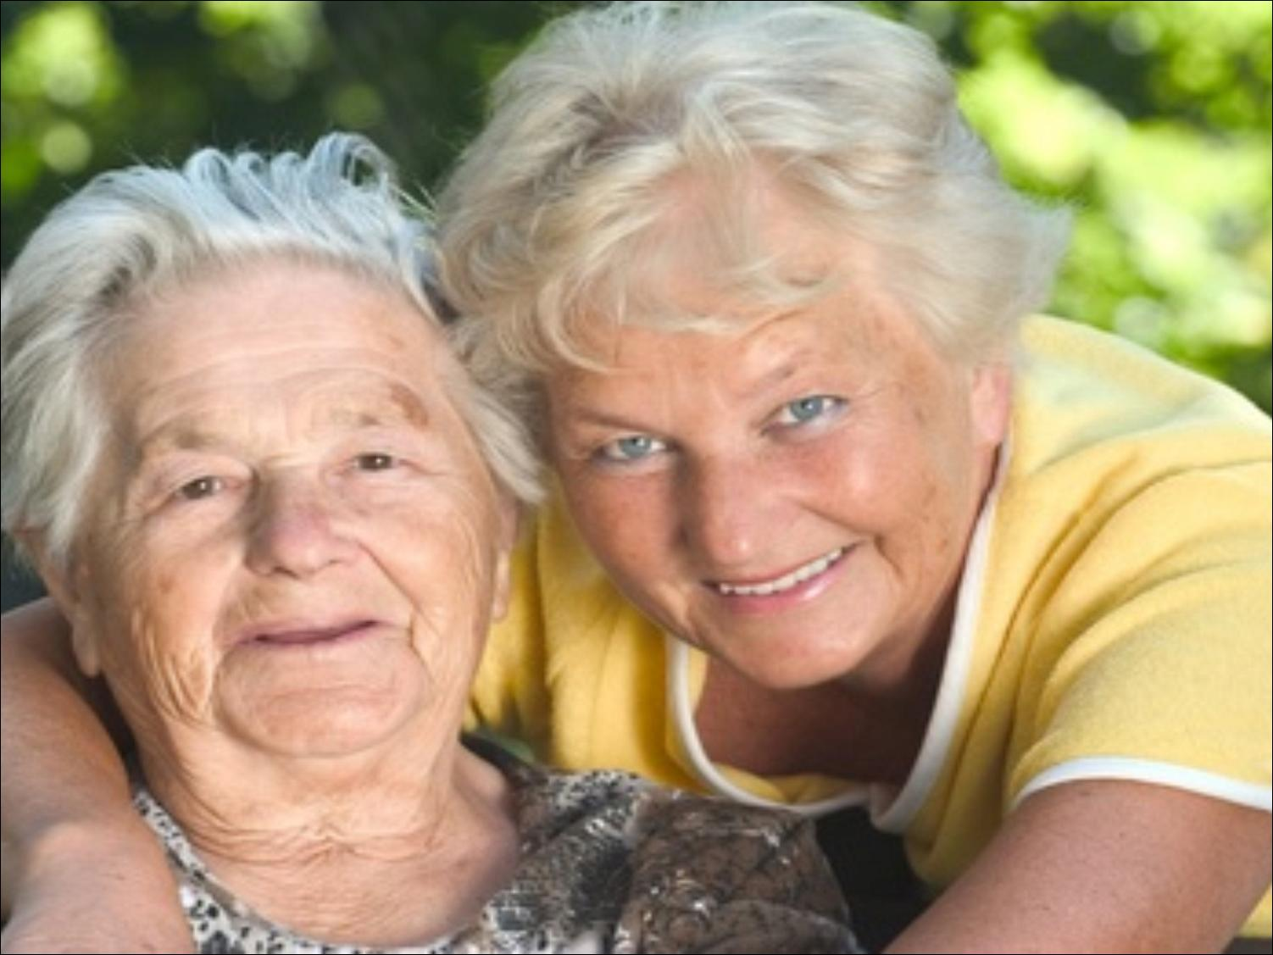
“What can be done to help will be done to help”
Lynden Jackson
Notes:
Finally, I want to emphasise once more that the people in this slide are the people whom The Debenham Project is all about. For those who work in the Social Services, the NHS, and the major charities they are generally referred to as “service users”, “customers”, “clients”, or “patients”. For us, however, they are Pat, Margaret, Dennis, Eunice, Les, Peter, Gillian, Sue, Sally, Rex, Norman, Olive, Joan, Reg, Jean, and so on many, many times over. They are our friends and neighbours and relatives – the people who we meet and chat to in the High Street – the people who want to care for and be cared for, but are struggling. They are personal and individual and they need caring for personally and individually.
In Suffolk, in June 2015 there were estimated to be 11,000 people with dementia. We can, sort of, translate this to about 20,000 people living with the impact of dementia on their lives – those with the illness and those who care for them. Yet at that time the total availability throughout the county of the sort of post-diagnosis support we offer in The Debenham Project was about 1,100 person sessions* per month which equates to less than half a day a year!! Since then the need has increased significantly but the provision hasn’t!! I do not believe that Suffolk is, in any way unique. What we urgently need to do is to double, triple, quadruple, the capacity of community-based activities, services and support – and then do it again!!
*(a couple of hours for a carer or their loved one)
The challenge we face is how to do this. The Dementia Friends and Dementia Friendly Communities initiatives have shown how much goodwill there is. Our challenge is how we convert all this awareness, understanding and goodwill into action. If the Debenham Project has a message, it is that if you start small, it will grow and evolve as time goes by until you look back and say “Wow! I would never have thought it possible”. I believe we have shown that it can be done. My challenge to you today is to go home and by just “getting on and do something” with your friends and neighbours, make a difference.
“I hope you liked my story”. Thank you.

